Slide 1

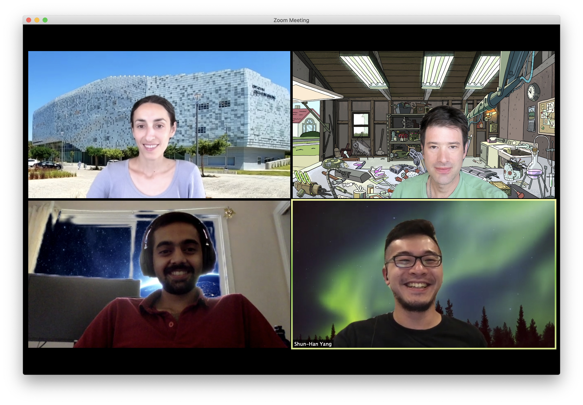



Global Guidance for Local Generalization in Model Checking
Hari Govind V K, Yu-Ting Chen,
Sharon Shoham, Arie Gurfinkel
@CAV 2020

Slide 2
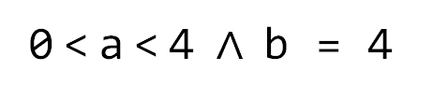
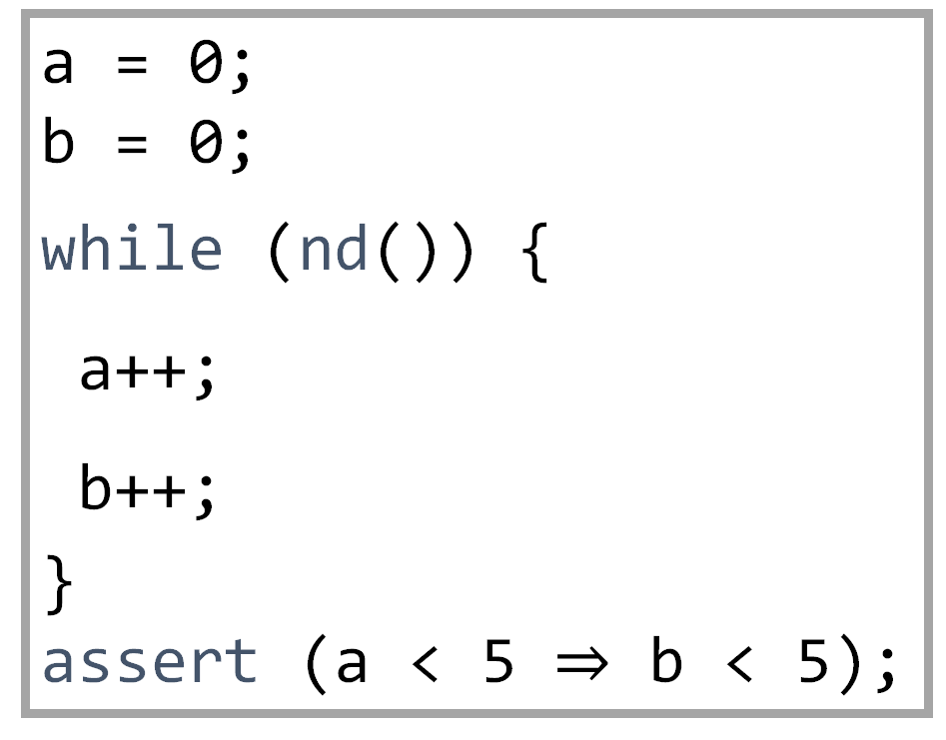
Space Odyssey of Spacer Tom
Engines ON!
Safety of infinite state systems
e.g., sequential programs
Generate inductive loop invariants
IC3-style Model Checking algorithms
Generate predecessors to Bad states (POB)
Block them and generalize (lemma)
Stop when you get an invariant
a = 0;
b = 0;
while (nd()) {
a++;
b++;
} assert (a < 5 $⇒$ b < 5);
0 < a < 4 $∧$ b = 4
a = b
a + b < 4
All variables are unbounded integers
nd() returns a non deterministic Boolean value.
Notes:
Think about sequential programs with just one loop. Our methods apply to a much more general setting of non-linear CHCs but for simplicity, this whole talk is going to be about single loop programs
Generalize to learn lemmas

Slide 3

Spacer Tom ONLY knows how to do
Local reasoning
Generalizing from single predecessors results in limited exploration horizon
Generalization typically relies on interpolation
Interpolation can work wonders! e.g., generate breakthrough terms like invariant a = b
Notes:
One aspect of such MC algorithms is local reasoning

Slide 4

Ground Control to Spacer Tom:
We've got a PROBLEM!
Not aware of the structure of the inductive proof so far
Interpolant is very much dependent on heuristics in the underlying SMT engine
a + b < 4 is just as likely as a = b
Much more crucial in infinite-state systems than in finite-state systems
There are usually infinite generalizations to choose from
Notes:
That is itp only works sometimes

Slide 5


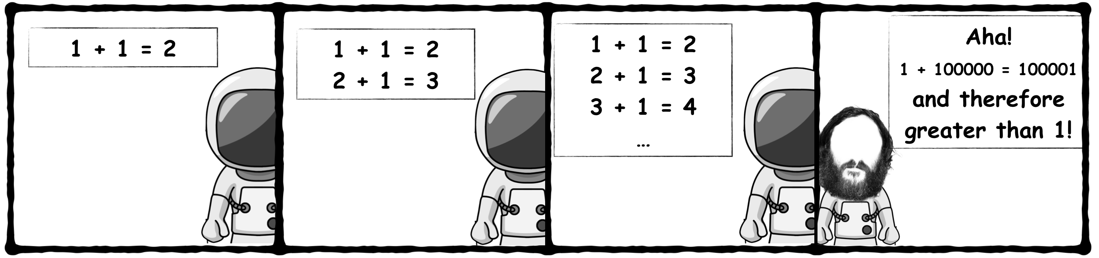
Spacer Tom can be MISSGUIDED!
As illustrated by
Myopic generalization
Excessive generalization
Getting stuck in a rut

Slide 6

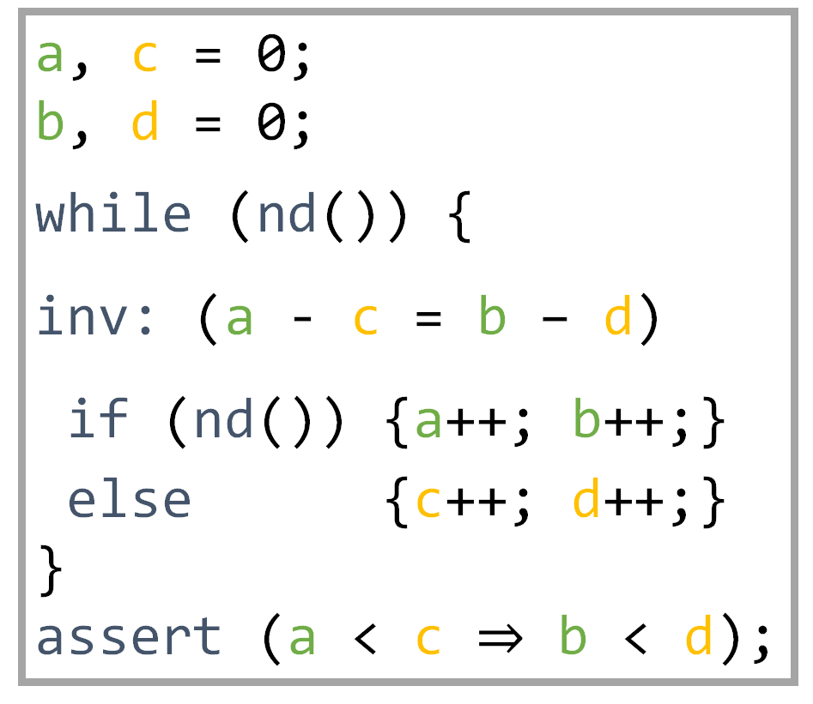
Spacer Tom can be MISSGUIDED!
Myopic Generalization
a, c = 0;
b, d = 0;
while (nd()) {
inv: (a - c = b – d)
if (nd()) {a++; b++;}
else {c++; d++;}
} assert (a < c $⇒$ b < d);
nd() returns a non-deterministic Boolean value.

Slide 7


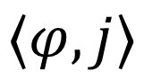

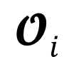
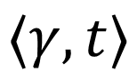
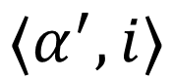


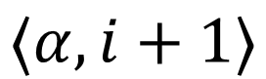

Ground Control to Spacer Tom:
Global Guidance
$$⟨α, i+1⟩$$
$$\text{𝓞}i$$
POB Queue
Lemma Trace
$${⟨α}^{′}, i⟩$$
$$ℓ$$
$$ℓ$$
$$⟨φ, j⟩$$
$$\text{ℒ}⊆\text{𝓞}\text{k}$$
$$⟨γ, t⟩$$
$$ψ$$
Notes:
We design a guidance technique that takes as input all lemmas in the trace, the proof obligation and the new lemma and give as out either a pob or a new lemma.

Slide 8
Ground Control to Spacer Tom:
Global Guidance trinity
Subsume
Concretize
Conjecture

Slide 9
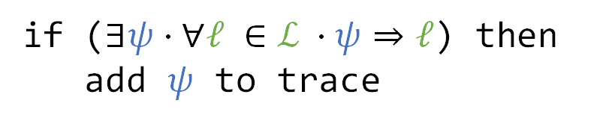
1st Global Guidance to GSpacer Tom:
Subsume Rule
if ($∃ψ⋅∀ℓ ∈\text{ℒ} ⋅ψ⇒ℓ$) then
add $ψ$ to trace

Slide 10
1st Global Guidance to GSpacer Tom:
Subsume Rule
if ($∃ψ⋅∀ℓ ∈\text{ℒ} ⋅ψ⇒ℓ$) then
add $ψ$ to trace

Slide 11
1st Global Guidance to GSpacer Tom:
Subsume Rule
if ($∃ψ⋅∀ℓ ∈\text{ℒ} ⋅ψ⇒ℓ$) then
add $ψ$ to trace

Slide 12
1st Global Guidance to GSpacer Tom:
Subsume Rule
if ($∃ψ⋅∀ℓ ∈\text{ℒ} ⋅ψ⇒ℓ$) then
add $ψ$ to trace

Slide 13

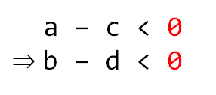


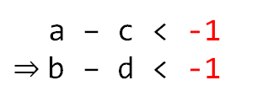
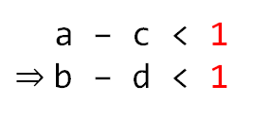
Subsume Rule in Action:
Subsume Rule on LIA
$$ℓ_{1}$$
a – c
a – c
a – c < 1 $⇒$b – d < 1
$$ℓ_{2}$$
a – c < 0 $⇒$b – d < 0
b – d
a – c < -1 $⇒$b – d < -1
$$ℓ_{3}$$
Notes:
These are the lemmas from the example in cube form.

Slide 14

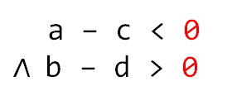


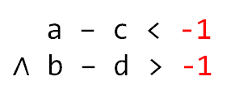
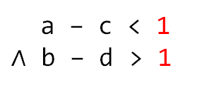
Subsume Rule in Action:
Subsume Rule on LIA
a – c
a – c < 1 $∧$ b – d > 1
$${¬ℓ}_{1}$$
a – c < 0 $∧$b – d > 0
b – d
a – c < -1 $∧$ b – d > -1
$${¬ℓ}_{2}$$
$${¬ℓ}_{3}$$
Notes:
These are the lemmas from the example in cube form.

Slide 15
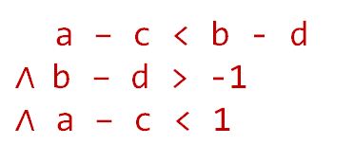
Subsume Rule in Action:
Subsume Rule on LIA
a – c
a – c < b - d $∧$b – d > -1
$∧$ a – c < 1
b – d

Slide 16
Subsume Rule in Action:
Subsume Rule on LIA
a – c
a – c < b - d
b – d

Slide 17

Subsume Rule in Action:
Subsume Rule on LIA
a – c
a – c
a – c
$$ψ$$
b – d
Notes:
These are the lemmas from the example in cube form.

Slide 18
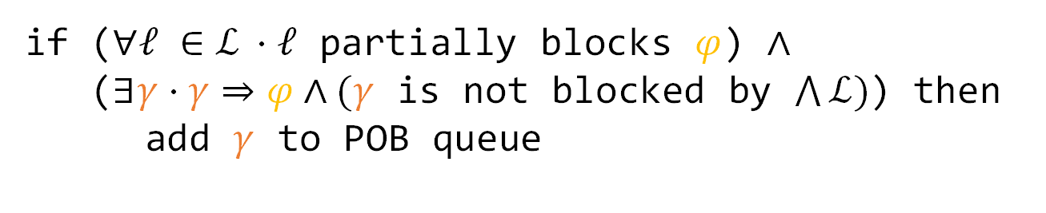
2nd Global Guidance to GSpacer Tom:
Concretize Rule
if ($∀ℓ ∈\text{ℒ} ⋅ℓ$ partially blocks $φ$) $∧$
($∃γ⋅γ⇒φ∧(γ$ is not blocked by $\bigwedge{\text{ℒ}})$) then
add $γ$ to POB queue

Slide 19
2nd Global Guidance to GSpacer Tom:
Concretize Rule
if ($∀ℓ ∈\text{ℒ} ⋅ℓ$ partially blocks $φ$) $∧$
($∃γ⋅γ⇒φ∧(γ$ is not blocked by $\bigwedge{\text{ℒ}})$) then
add $γ$ to POB queue

Slide 20
2nd Global Guidance to GSpacer Tom:
Concretize Rule
if ($∀ℓ ∈\text{ℒ} ⋅ℓ$ partially blocks $φ$) $∧$
($∃γ⋅γ⇒φ∧(γ$ is not blocked by $\bigwedge{\text{ℒ}})$) then
add $γ$ to POB queue

Slide 21
2nd Global Guidance to GSpacer Tom:
Concretize Rule
if ($∀ℓ ∈\text{ℒ} ⋅ℓ$ partially blocks $φ$) $∧$
($∃γ⋅γ⇒φ∧(γ$ is not blocked by $\bigwedge{\text{ℒ}})$) then
add $γ$ to POB queue

Slide 22

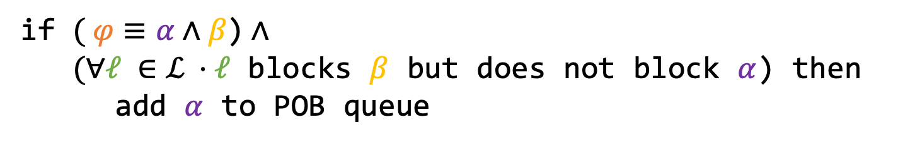
3rd Global Guidance to GSpacer Tom:
Conjecture Rule
if $( φ≡α∧β\text{)}$ $∧$
$(∀ℓ ∈\text{ℒ} ⋅ℓ$ blocks $β$ but does not block $α$) then
add $α$ to POB queue

Slide 23
3rd Global Guidance to GSpacer Tom:
Conjecture Rule
if $( φ≡α∧β\text{)}$ $∧$
$(∀ℓ ∈\text{ℒ} ⋅ℓ$ blocks $β$ but does not block $α$) then
add $α$ to POB queue

Slide 24
3rd Global Guidance to GSpacer Tom:
Conjecture Rule
if $( φ≡α∧β\text{)}$ $∧$
$(∀ℓ ∈\text{ℒ} ⋅ℓ$ blocks $β$ but does not block $α$) then
add $α$ to POB queue

Slide 25
3rd Global Guidance to GSpacer Tom:
Conjecture Rule
if $( φ≡α∧β\text{)}$ $∧$
$(∀ℓ ∈\text{ℒ} ⋅ℓ$ blocks $β$ but does not block $α$) then
add $α$ to POB queue

Slide 26
3rd Global Guidance to GSpacer Tom:
Conjecture Rule
if $( φ≡α∧β\text{)}$ $∧$
$(∀ℓ ∈\text{ℒ} ⋅ℓ$ blocks $β$ but does not block $α$) then
add $α$ to POB queue

Slide 27
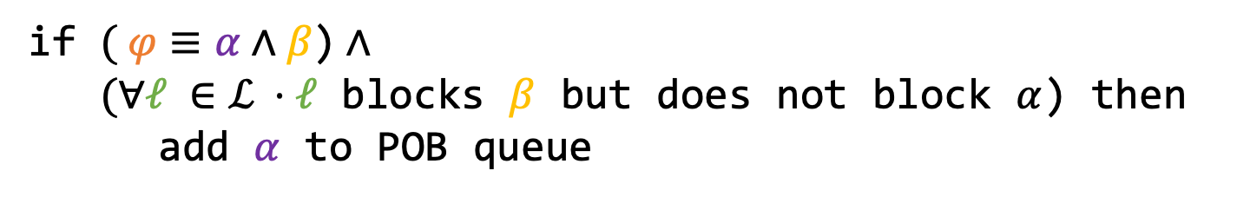
3rd Global Guidance to GSpacer Tom:
Conjecture Rule
if $( φ≡α∧β\text{)}$ $∧$
$(∀ℓ ∈\text{ℒ} ⋅ℓ$ blocks $β$ but does not block $α$) then
add $α$ to POB queue

Slide 28
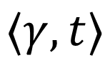

Ground Control to Spacer Tom:
Global Guidance
$$⟨α, i+1⟩$$
$$\text{𝓞}i$$
POB Queue
Lemma Trace
$${⟨α}^{′}, i⟩$$
$$ℓ$$
$$ψ$$
$$⟨γ, t⟩$$
$$ℓ$$
$$⟨φ, j⟩$$
$$\text{ℒ}⊆\text{𝓞}\text{k}$$
Conjecture
Concretize
Subsume
Notes:
We design a guidance technique that takes as input all lemmas in the trace, the proof obligation and the new lemma and give as out either a pob or a new lemma.

Slide 29
Implementation and Evaluation
As an extension to Spacer
https://github.com/hgvk94/z3/tree/gspacer-cav-ae
Supports
Linear Integer Arithmetic, Linear Real Arithmetic
Linear and Non-linear CHCs
Arrays and Fixed-Size Bit-Vectors ongoing
Evaluated on LIA instances from CHC-COMP

Slide 30
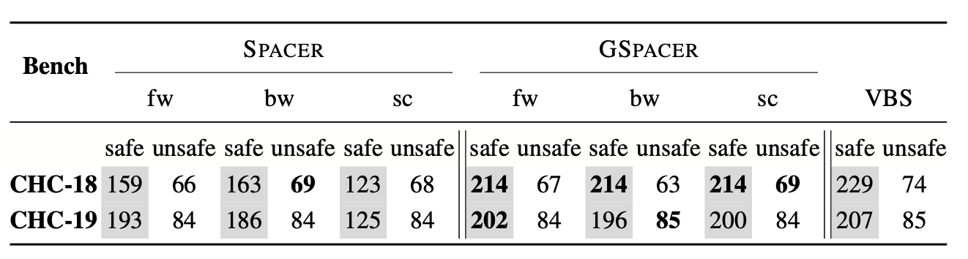
No interpolation!
Results
fw and bw are different interpolation strategies.
sc configuration disables interpolation.
GSpacer won 3 of the 4 tracks at CHC-COMP 2020
Notes:
We compared with Spacer with a timeout of 10 mins

Slide 31

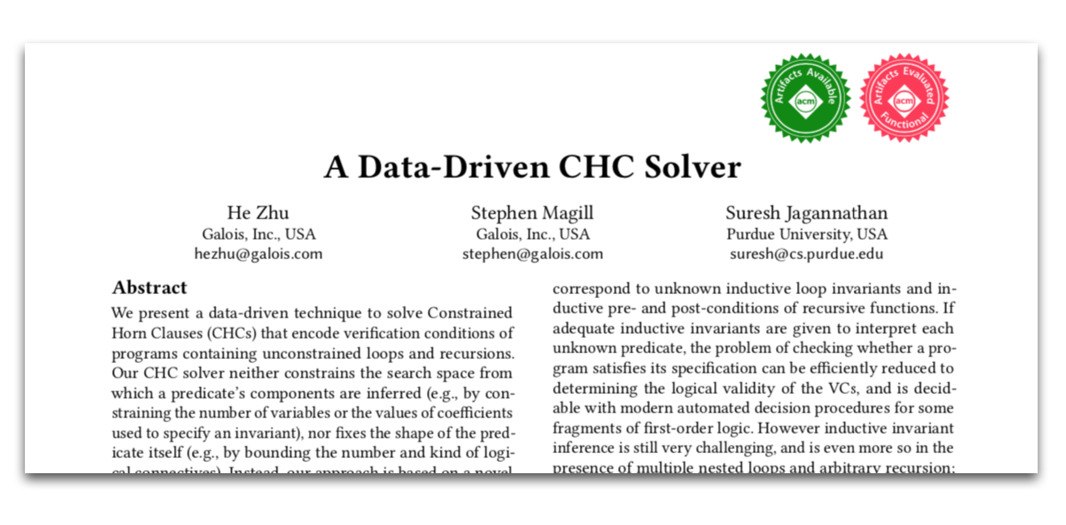
Linear Arbitrary (LArb) from PLDI 18
Data-driven, machine learning based invariant inference algorithm
Evaluation showed promise on a subset of SV-COMP benchmarks

Slide 32
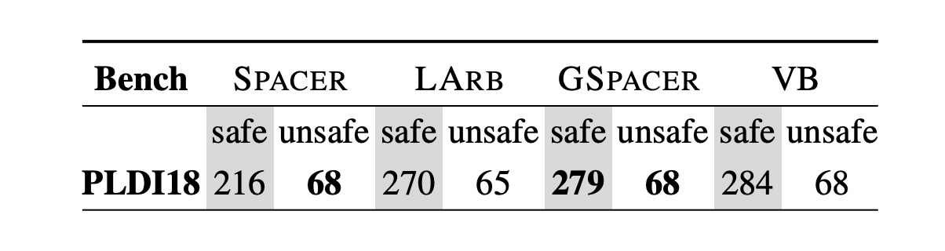
We compared GSpacer with LArb
Could not compare on CHC-COMP instances as LArb solved significantly fewer instances than even Spacer
Compared on benchmarks from LArb paper
VB stands for virtual best

Slide 33
Conclusion
a – c
Ground Control to Spacer Tom:
Global Guidance
POB Queue
Lemma Trace
Conjecture
Concretize
Subsume
Global guidance technique to mitigate limitations of local reasoning
Stable under different interpolation strategies
Data driven guidance for MC is better than both invariant inference and local reasoning

Slide 34
Future Work
Extend to theories where there is no interpolation
BV, Arrays
Add more rules
Symmetry breaking in distributed protocol verification
34

Slide 35
Thanks for listening
https://hgvk94.github.io/gspacer/

